Slide 1
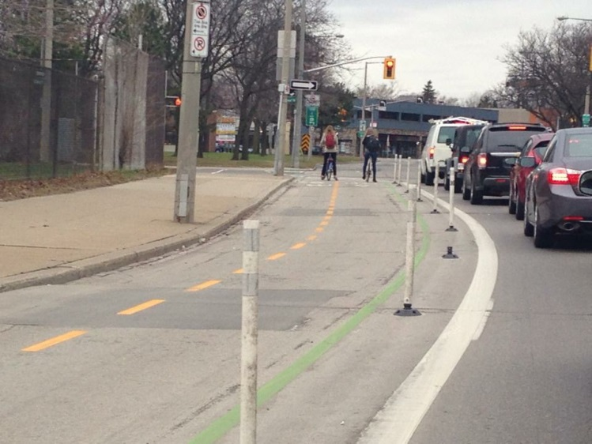
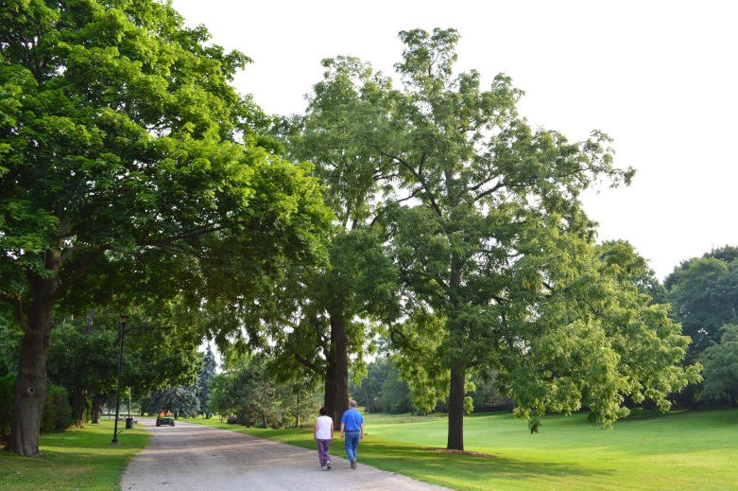
2015
Mayor’s Breakfast
Momentum into Results
#MayorsView
Notes:
Thank you to Hamilton Chamber of Commerce
Sponsors Bell, Union Gas
WELCOME!
Minister McMeekin
Councillors: Lloyd Ferguson, Chad Collins, Jason Farr, Doug Connley and Aidan Johnson
City Manager and Staff
Disclaimer: I’d like to talk about everyone, and all the great things happening in our City.
I can’t mention and include everyone. I would love to. All organizations are important to our success.

Slide 2
Last month we
“Turned it On” at the JUNO Awards!
Notes:
Last month Hamilton “Turned It On” at the Juno Awards!

Slide 3
Collectively, we put Hamilton in the national spotlight
Notes:
Collectively, we put Hamilton in the national spotlight.
Centre stage for a weekend of entertainment, arts and culture and showcased our vibrant downtown.

Slide 4
The challenge now Hamilton,
for each of you here today, is how will YOU
“Turn it On” every day?
Notes:
The challenge now Hamilton, for each of you here today, is how will YOU “Turn It On” every day?

Slide 5
Momentum into Results
I believe it’s important that we find the balance;
Equal parts focused on further development and celebrating our successes in the moment.
We have so much to be proud of.
Notes:
I believe it’s important that we find the balance; equal parts focused on further development and celebrating our successes in the moment.
We have so much to be proud of.
Recognizing the efforts of my council colleagues, city staff and community leaders, private sector partners - is paramount to achieving future success.

Slide 6
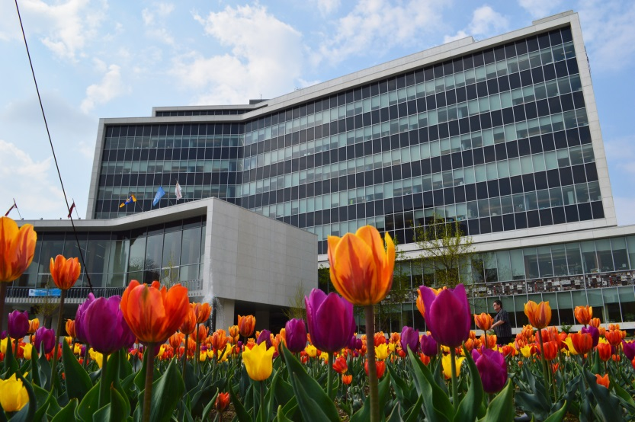
Priorities for Hamilton
Economic Development
Transit
Infrastructure
Poverty Reduction & Affordable Housing
Notes:
Top Priorities I’d like to talk to you about today.
Economic Development
Transit – building a sustainable city for everyone
Infrastructure
Poverty Reduction & Affordable Housing

Slide 7
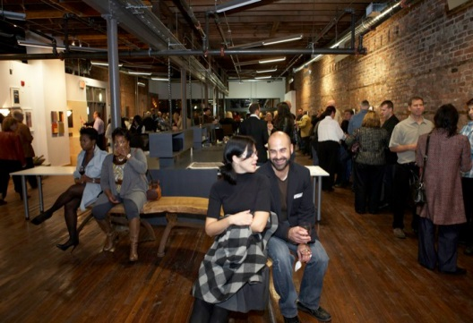
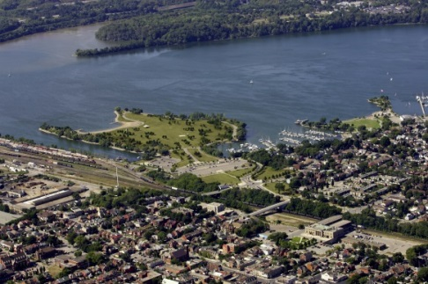
Economic Development Highlights
Investing in the arts
Waterfront
US Steel lands
Airport Employment Growth District
Notes:
Economic Development Highlights
Investing in the arts
Waterfront
US Steel lands
Airport Employment Growth District

Slide 8
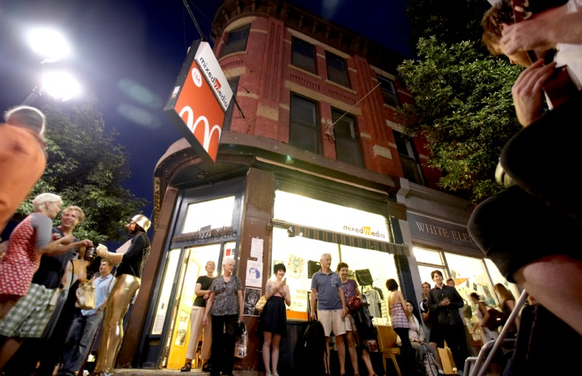
Investing in the arts
Notes:
important to the City to Support the Arts funding
Culture certainly generates economic benefits in cities and neighbourhoods in which it flourishes
it more than earns what it costs city government and the taxpayers.
Yet it should not have to justify itself by economic payoff

Slide 9
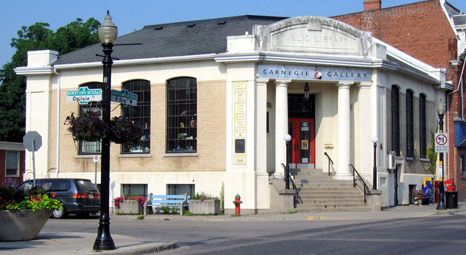
Investing in the arts
Investing in the arts
Notes:
The recent JUNO Awards is one great example of how investing in the arts benefits the entire city
Local restaurants, shops, transportation
Not only a ‘feel good’ for the City, but Gave us National exposure

Slide 10
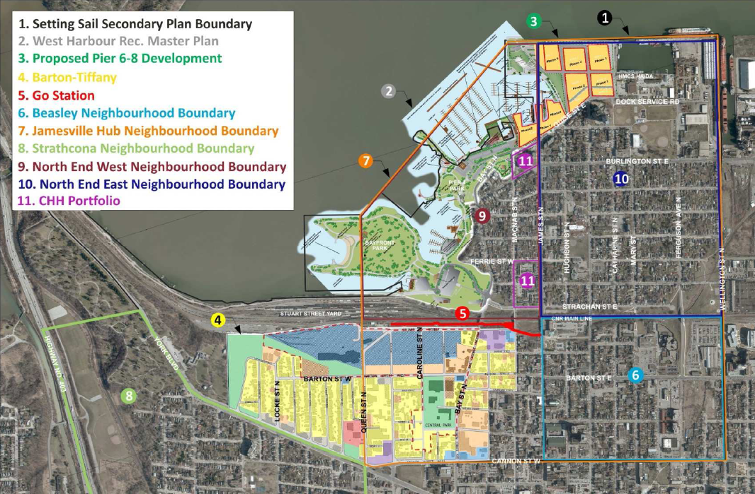
waterfront
Notes:
Emerging, not just vision, Community Engagement ramping up
Waterfront is several steps closer to “Shovel Ready”
Piers 7 & 8 Marina Management Agreement and Lease Termination with the HPA
Barton-Tiffany Urban Design Study, James St. N Mobility Hub Study
OPA for Piers 5-7 to implement Rec Master Plan
Agreement for Pipeline re-location on Piers 7 & 8
Design for Pier 7 Transient dock and shoreline renewal
Functional design with Harbour West & RHYC Marina
Design of Sanitary Pumping Station for Piers 5-8

Slide 11
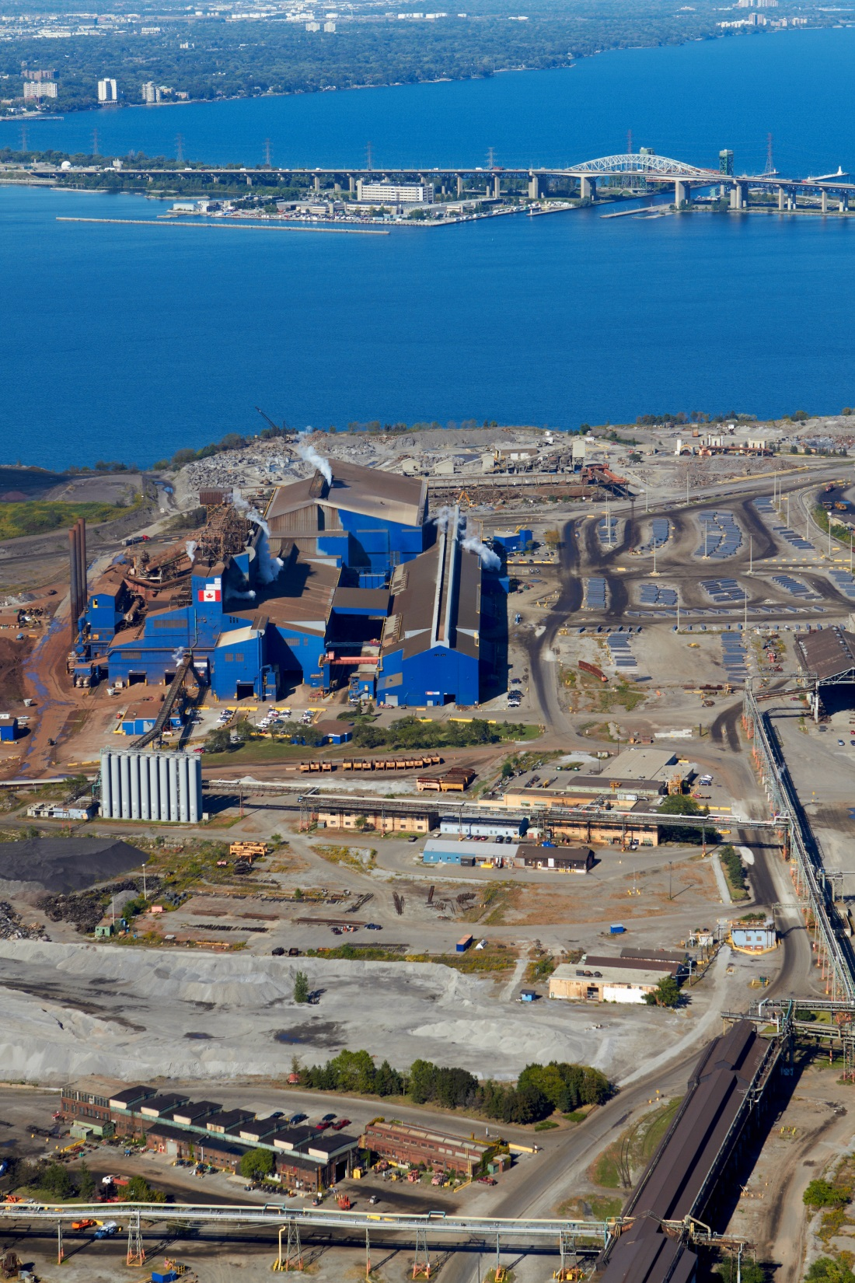
US Steel Lands
Notes:
forward moving opportunity

Slide 12
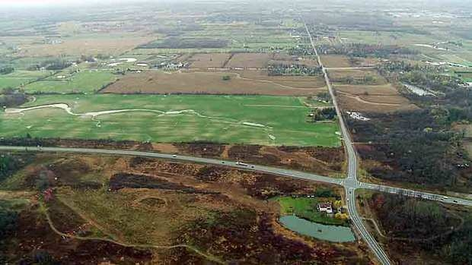
Airport Employment Growth District
Notes:
Airport Employment Growth District
Projected Growth in the next 25 years -- 780,000 people and 350,000 jobs.
And - So far - the City’s growth has been meeting the Province’s Places to Grow forecasts.
Recently in the news the OMB approved the AEGD settlement - allowing for the AEGD area to proceed.
As part of the settlement, the City agreed to begin the planning process for the 2031-41 time period.
This review will be conducted in conjunction with the Provincial Places to Grow and Greenbelt Plan review scheduled this year.
As long as development is occurring, people will buy here and stay here.

Slide 13
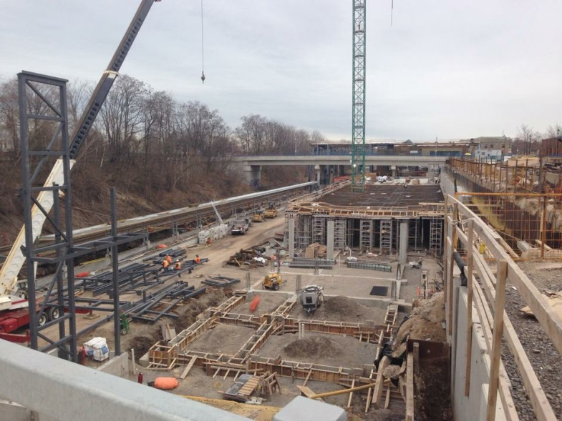
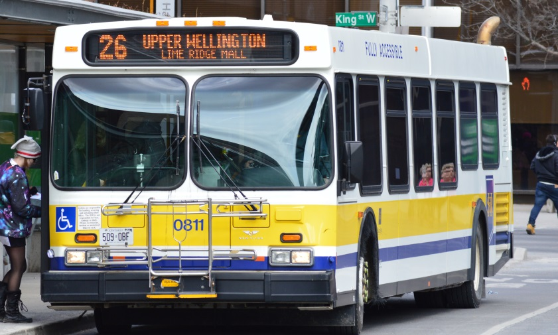
Transit Highlights
LRT& it’s Economic uplift
Bus Infrastructure
All Day Go Service
Citizen Engagement
Notes:
Transit Highlights
LRT& it’s Economic uplift
Bus Infrastructure
All Day Go Service
Citizen Engagement

Slide 14
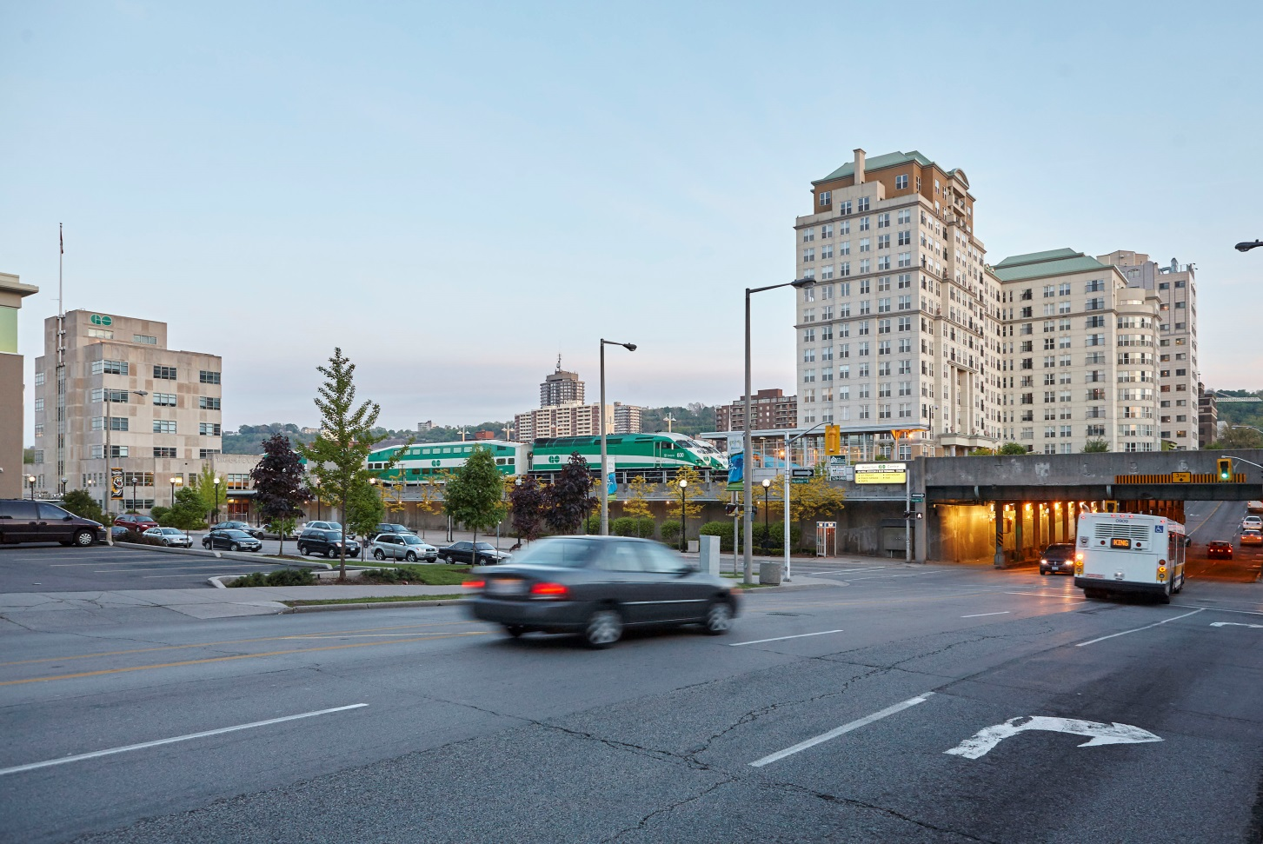
Notes:
Bus Infrastructure, LRT& it’s Economic uplift
building a sustainable city for everyone
Cities that have built LRT lines (such as Portland, Oregon; Dallas, Texas; and Minneapolis, Minnesota) have found that in addition to making it easier for residents and workers to get around
creating economic development opportunities, LRT lines and their stations attract investment by developers
LRT stations become the focus of new development and economic activity, while improving the quality of life for city residents and workers.
New investment tends to attract further investment, making certain transit stations the focus of clusters of office employment, shops and restaurants, with associated services.

Slide 15
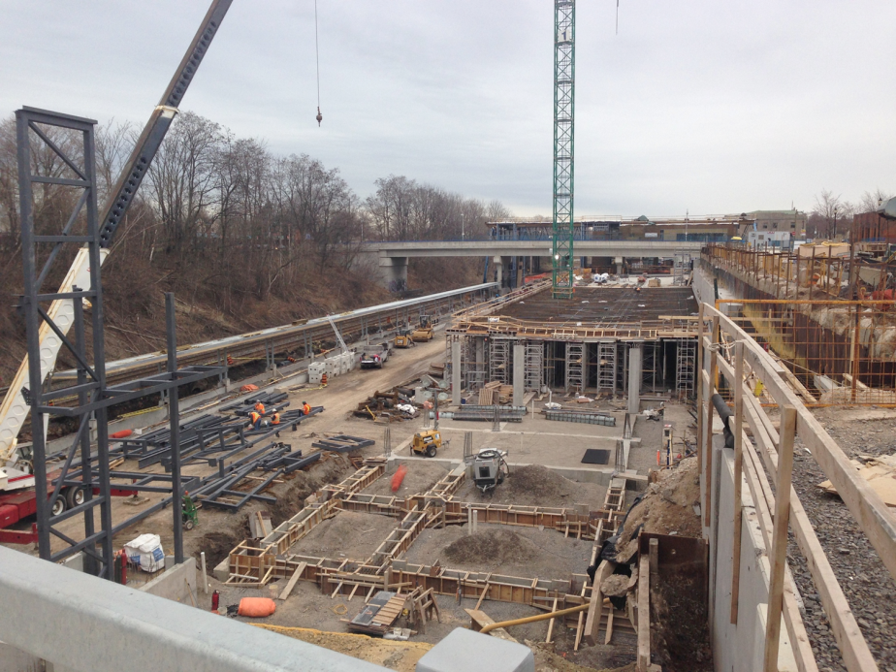
Notes:
All Day Go Service
four trains will run between Toronto and the city through the new $58-million James Street North station by the end of 2016.
By the end of a 10-year "regional express rail" (RER) plan, city commuters can expect:
15-minute rush-hour service in the peak direction between Hamilton GO Centre (Hunter Street) and Union Station;
in Hourly rush-hour service in the non-peak direction between Hamilton GO Centre and Union;
30-minute rush-hour service in the peak direction between the new James North station and Union;
Hourly service both ways for the rest of the day (not including rush hours), during evenings and weekends between Hamilton GO Centre and Union.
Work continues on the new GO station at James Street North despite the fact that the province says that 15-minute Hamilton GO train service is up to 10 years away.

Slide 16
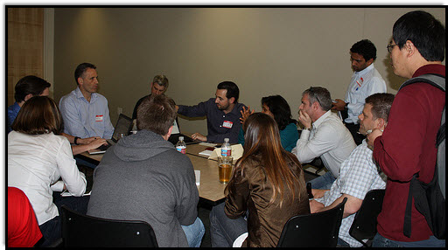
Citizen’s Jury on Public Transit
Notes:
Citizen’s Jury on Public Transit and Area Rating
Meaningful civic discourse to discuss transit
Participatory democracy – Jury model
open – transparent- inclusive – process. Important to build in a strong communications and education strategy to engage the broader public
Designed to bring people together to foster a dialogue, complete with divergent views.
Citizen’s helping to shape public policy. Shared responsibility between government and citizens.
Enhance community’s capacity to address complex and controversial issues

Slide 17
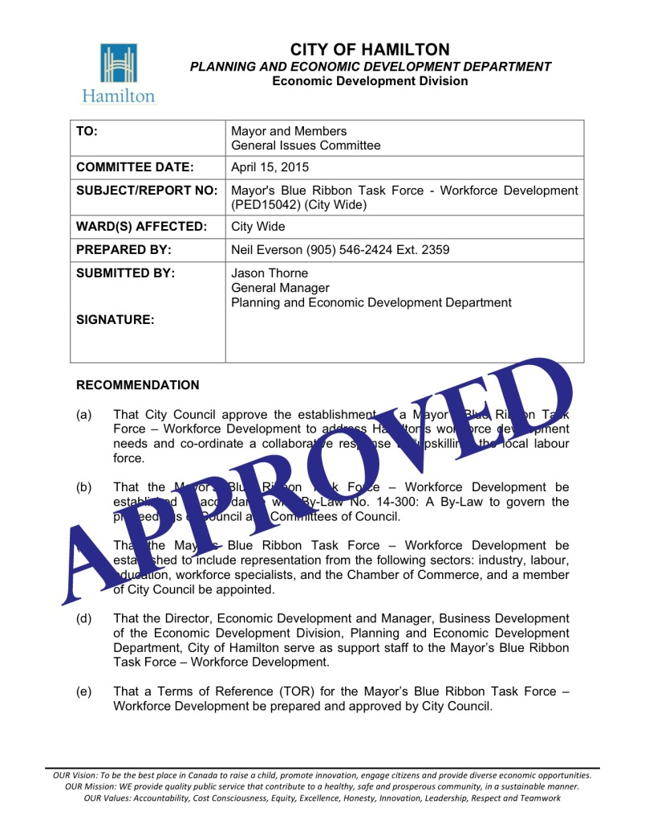
Workforce Development
City’s focus on diversification of the local economy has been clearly vindicated in our consistent low unemployment rates and by the growth of our building permits in all categories.
Notes:
Workforce Development
City’s focus on diversification of the local economy has been clearly vindicated in our consistent low unemployment rates
and by the growth of our building permits in all categories.
Problem that confronts us now – skilled labour market.
Council has endorsed the establishment of the “Mayor’s Blue Ribbon Task Force on workforce development.
Commitment to increasing and developing a skilled workforce for today and the future
To strengthen the partnerships between industry, Economic Development and Education
Ron McKerlie, President of Mohawk has agree to Co-Chair the taskforce.

Slide 18
Global Hamilton
Foreign Direct Investment Strategy and Global Hamilton
Engaging diverse entrepreneurs in developing business here and abroad
Notes:
Global Hamilton
Foreign Direct Investment Strategy and Global Hamilton
Engaging diverse entrepreneurs in developing business here and abroad
Dedicated action plan that will assist our local industry’s growth.
Developing economies present us with unique opportunity
Recognize that our local industry leaders act as our cities strongest advocates and sector ambassadors -- which can translate into credible leads and further investment for our city
After breakfast today I’m meeting with Indian Consul General local entrepreneurs

Slide 19
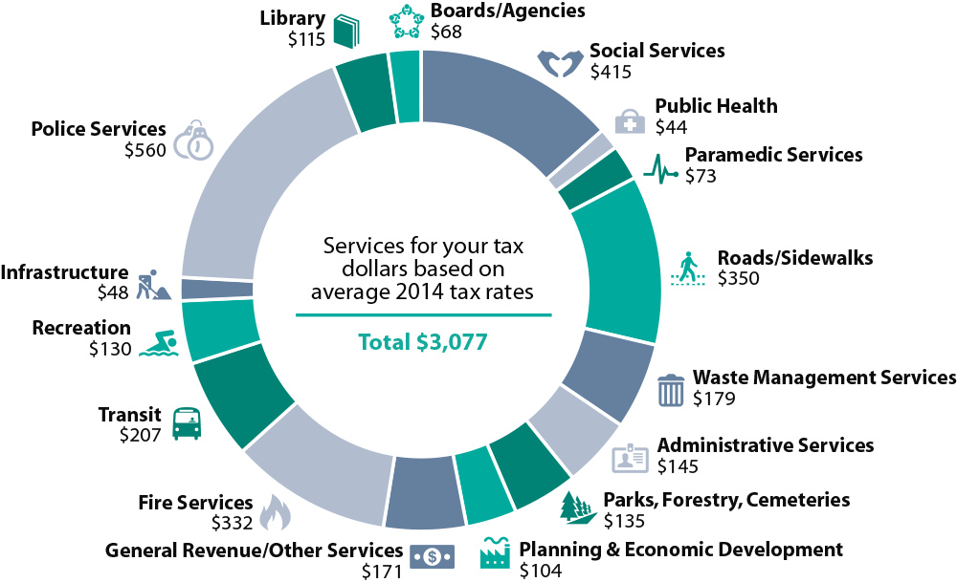
Budget Highlights
Notes:
2015 CAPITAL BUDGET APPROVED IN FEBRUARY
Capital Infrastructure Investment highlights include:
$82.6 million for roads maintenance
$16.6 million for growth related road improvements
$13.1 million for transit buses
$11 million for other transit priorities
$14.4 million in corporate and recreation facilities in need of rehabilitation
$11 million for West Harbour Strategic Initiatives
Thank you to senior staff and Mike Zegarac and his team in particular, the Clerks,
Councillors for this is our first budget of this term and of course the taxpayers of the City of Hamilton.

Slide 20
Budget Highlights
Notes:
Very Pleased by the unanimous Council support for Arts Funding - $500,000 And Community Foundation
Arts sector bolsters economic development
Reduced reliance on reserves
We put money back to boost infrastructure investment
Additional municipal Transit funding
Economic Growth Investments – Fundamental issue for the City
i.e. Additional Resources to ensure we’re – ‘Open for Business’
Future generations will pay if we fail to invest today
This is a reasonable budget
130 FTEs = 31 Paramedics 51 Bus Operators 20 OW staff
additional staff address issues of public safety/ and assures enhanced service levels
Predominately in Planning / Open for Business

Slide 21
Infrastructure Highlights
Reality is we are in need of investing money for improvements
Notes:
Reality is we are in need of investing money for improvements

Slide 22
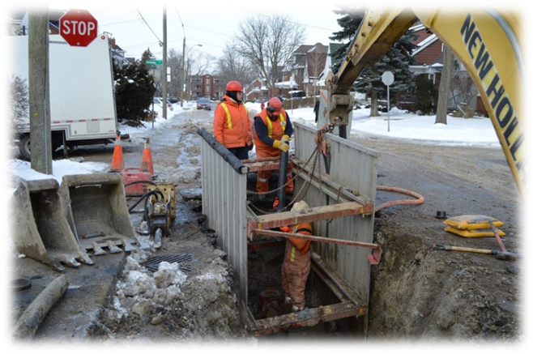
Infrastructure
infrastructure
Notes:
Long-term debt by 2019 to $885 million – or $1,521 per resident
Estimated backlog of $195 million a year, with the total backlog nearing $3.3 billion (including debt)

Slide 23
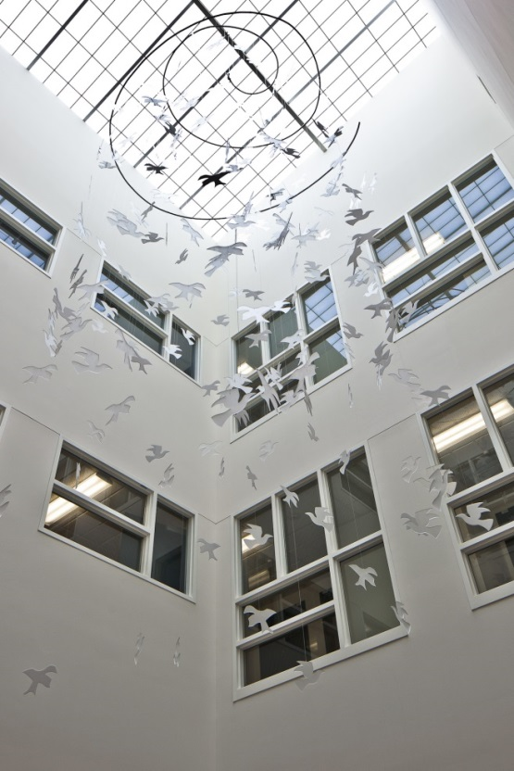
Poverty Reduction & Affordable Housing
The Housing Services Division has developed a 10-Year Housing and Homelessness Action Plan.
Notes:
Poverty Reduction & Affordable Housing
The Housing Services Division has developed a 10-Year Housing and Homelessness Action Plan.
It is a comprehensive solution-focused and person-centred plan
to guide decision making on how the Hamilton community will address affordable housing and homelessness issues.
Through provincial-federal Investment in Affordable Housing funding, 82 new affordable rental units are currently under development.
We expect to be able to build approximately 100 more in the next few years.

Slide 24
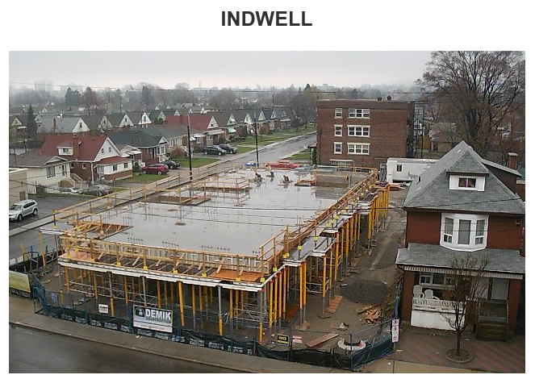
Rudy Holst Commons
Notes:
The Rudy Holst Commons - a new build
The next photo is of the Perkins Centre.
Both projects are funded through the Investment In Affordable Housing Program which is provincial and federal funding.

Slide 25
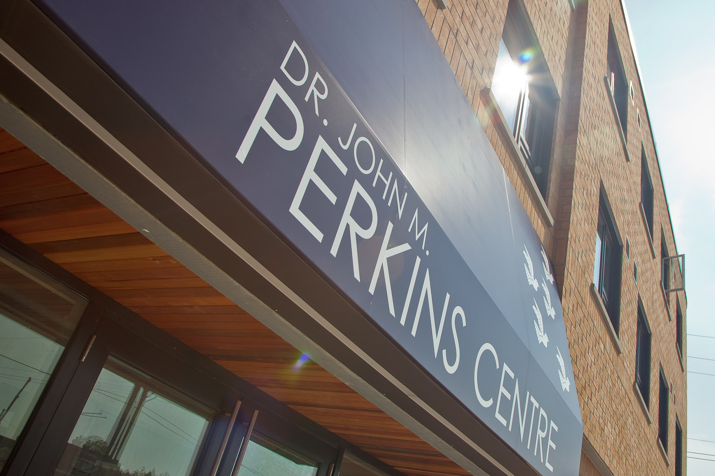
Rudy Holst Commons
Notes:
The City also provides financial contribution to the projects through waiving the Development Charges
Both projects are located at Main and Kenilworth.
They are both Indwell projects ( previously called Homestead Christian Care)
a great organization that creates affordable housing communities that support people seeking health, wellness and belonging

Slide 26
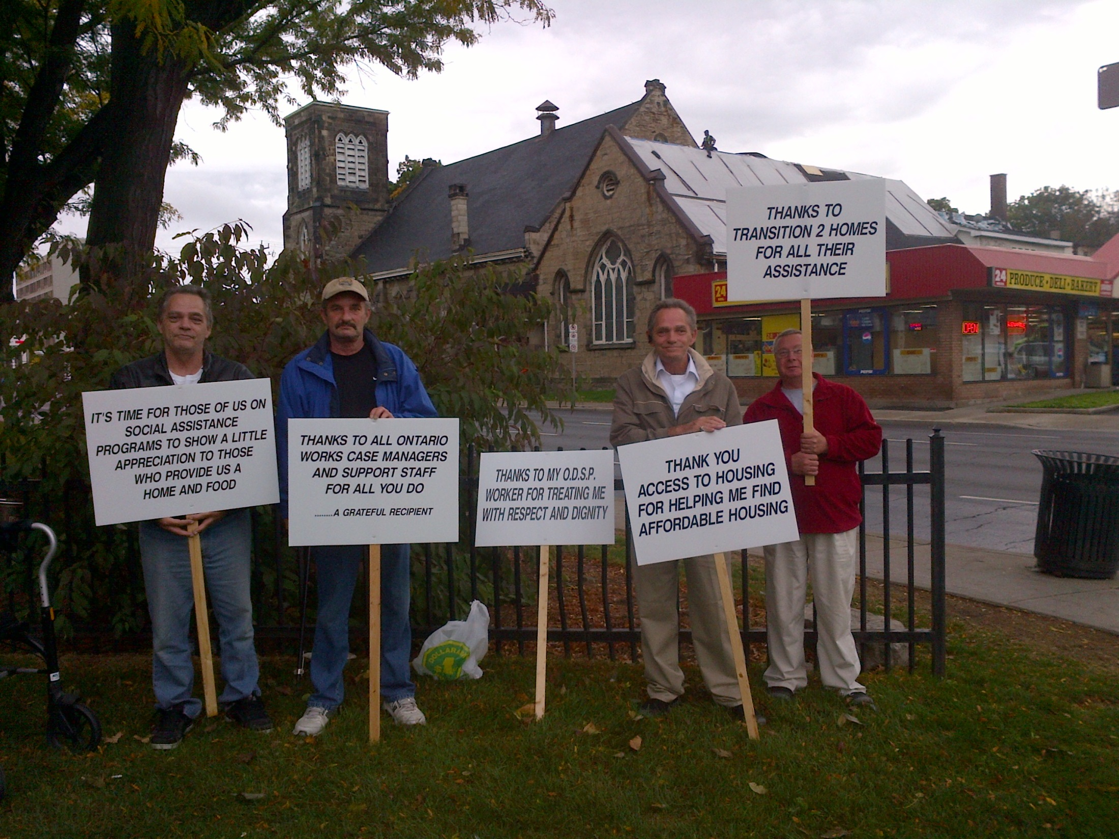
Notes:
Positive Picketers - who were giving thanks to the programs that support them

Slide 27
The City of Hamilton, with the support of community partners, is taking part in the 20,000 Homes Campaign.
The 20,000 Homes Campaign is a national movement of communities working together to permanently house 20,000 of the most vulnerable people experiencing homelessness in Canada by July 1, 2018.
Notes:
The City of Hamilton, with the support of community partners, is taking part in the 20,000 Homes Campaign.
The 20,000 Homes Campaign is a national movement of communities working together to permanently house 20,000 of the most vulnerable people experiencing homelessness in Canada by July 1, 2018.
In spite of being affordable compared to GTA neighbours – CHALLENGE – many families cannot afford a home.
5,500 families on the social housing wait list, 20% of renters paying more than 50% of their incomes on rent.
Market is changing – higher density housing - seeing high rise projects
City needs to make building NEW moderately priced housing attractive.

Slide 28
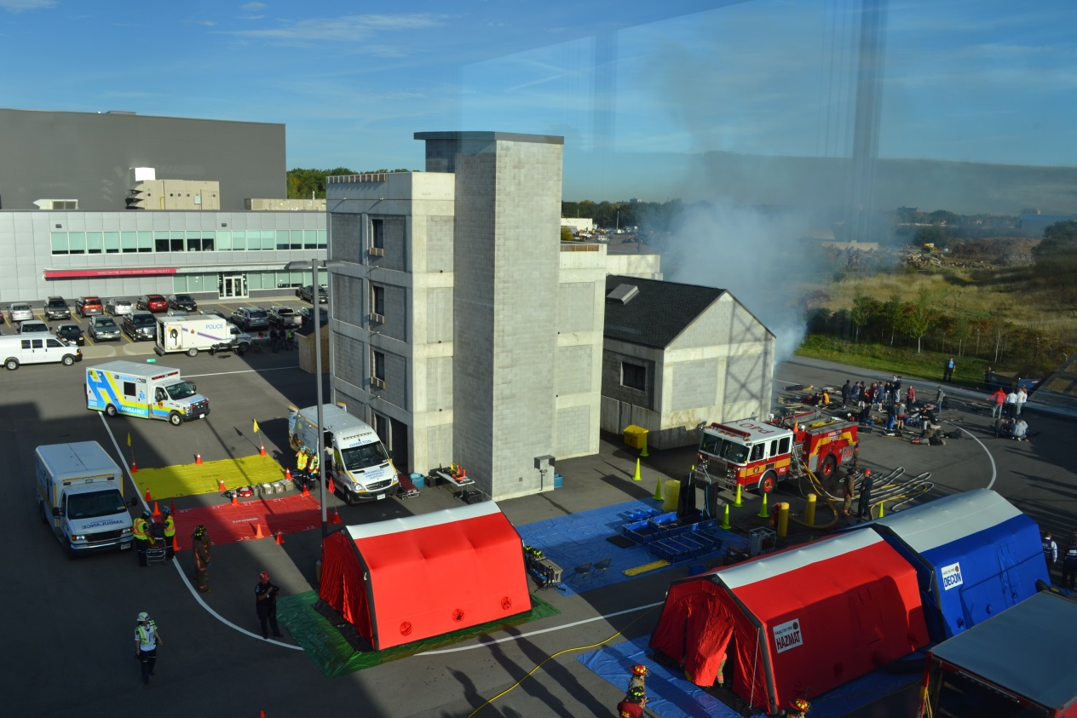
Hamilton Police Services
Notes:
Hamilton Police Services is the FIRST of it’s kind in Canada to introduce an innovative approach to dealing with those in mental health crisis.
Mobile Crisis Rapid Response Team (RRT), which is currently being piloted, aims to get mental health professionals on site faster than if they were part of a secondary response team.
was created with the help of St. Joseph’s Hospital and involves pairs of specially trained patrol officers with a mental health worker taking calls involving people in crisis.
These kinds of innovative approaches are evidence we are using effective, proven crime management strategies and the work of Hamilton Police continues to protect citizens from victimization
Members of our Service continue to focus on the community and the delivery of quality policing.
Saying we have 3,000 fewer arrests in the last year might not sound glamourous, but it’s significant.
Safety and Security are important. And we are committed to making this a priority.

Slide 29
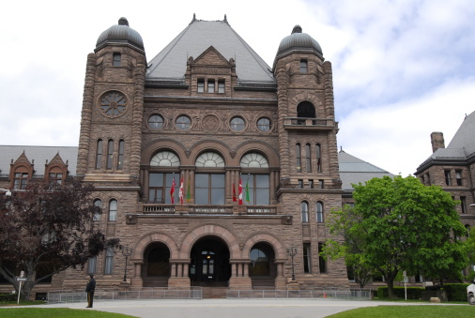
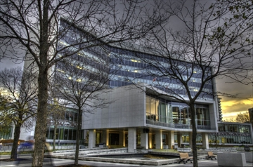
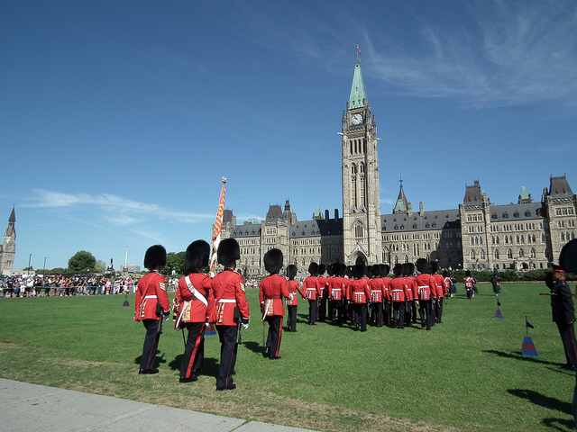
Inter-Government Relations
Notes:
importance of your Relationships with all levels of government
building on your relationships
recent / upcoming meetings
keeping lines of communication open

Slide 30
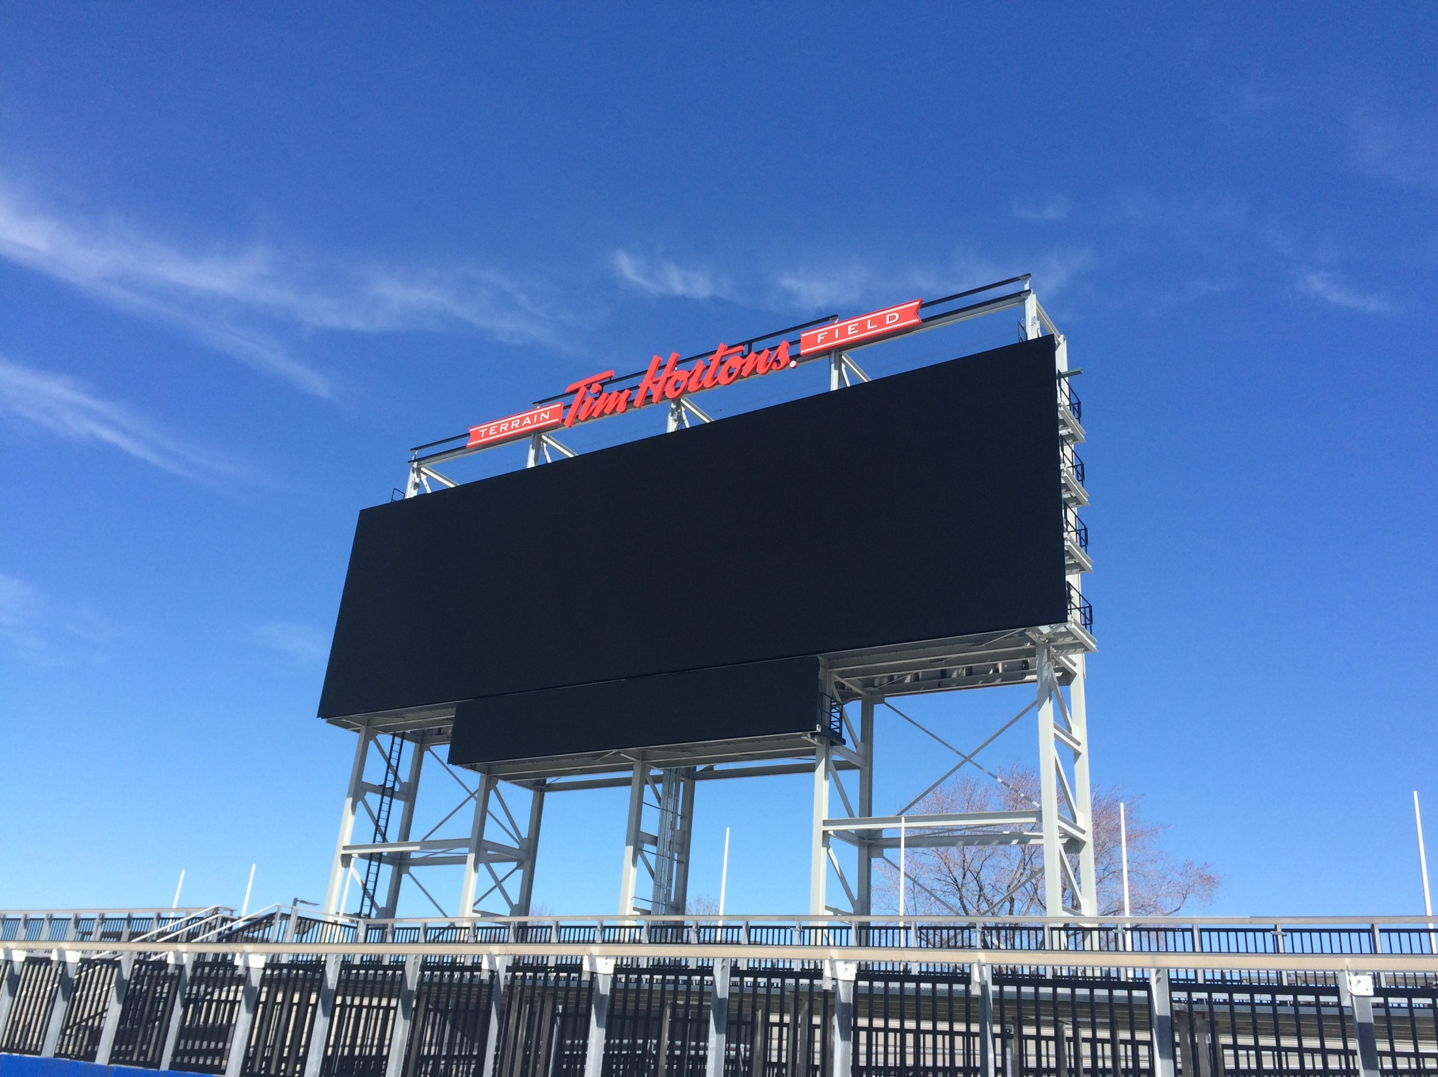
Stadium Update
Notes:
Stadium Update
City of Hamilton issued a full occupancy permit for Tim Hortons Field.

Slide 31
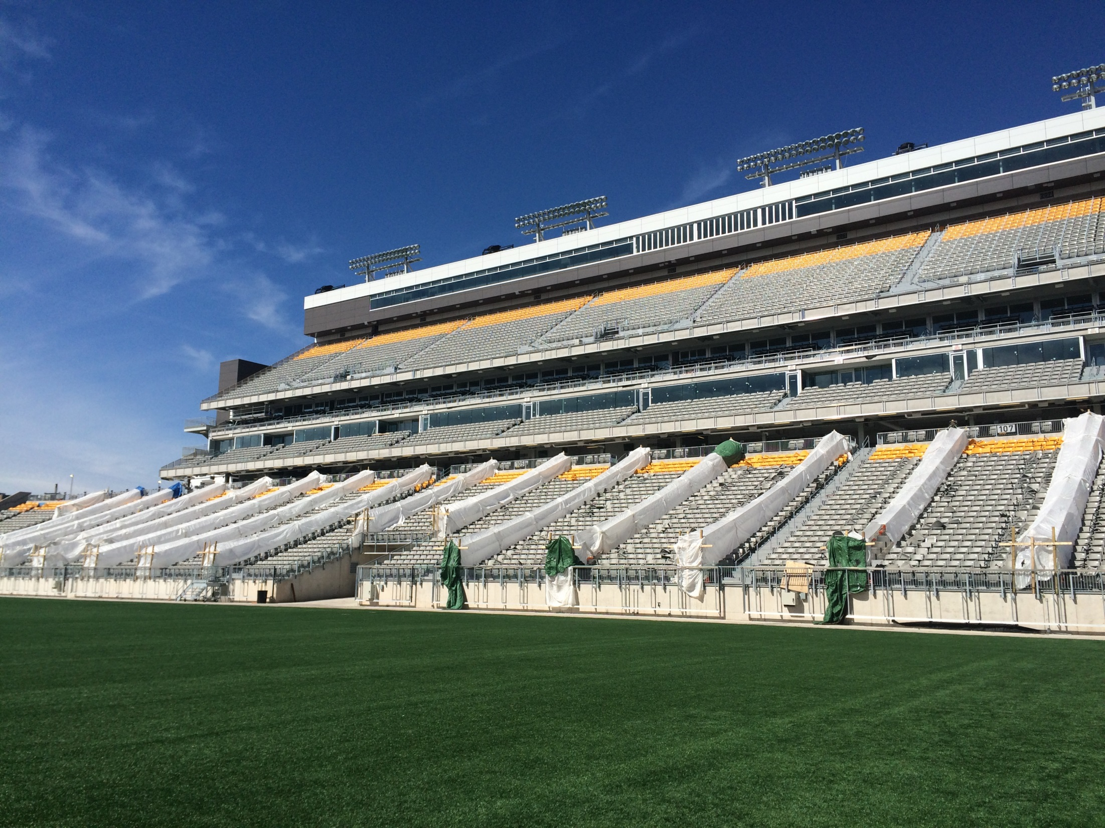
Notes:
Last week, City of Hamilton building inspectors walked through the entire building to examine hundreds of components and to conduct safety checks in all areas.
This safety check is the most critical aspect of the building inspection process.
Unfortunately some, if not all, scheduled May events will be cancelled as we don’t have Substantial Completion of the stadium
Therefore City Staff are not able to get in there, trained and ready to go.
Updates will be made as new information is available

Slide 32
Notes:
PAN AM Update
From July 10 – 26 Hamilton will experience 16 days of events on and off the field:
Food, Dance, Entertainment, Concerts, Multicultural Celebrations
Accessible and Affordable
In 77 days our province will host the largest multi-sport games in our nation’s history.
7,500 athletes from 41 countries will compete for gold on home soil.
This is the single largest call ever for volunteers as TO2015 will have 25,000 volunteers at the venues across the games footprint.
We are about to celebrate as our city hosts the most watched, celebrated and participated sport in the world often described as the beautiful game – Soccer!

Slide 33
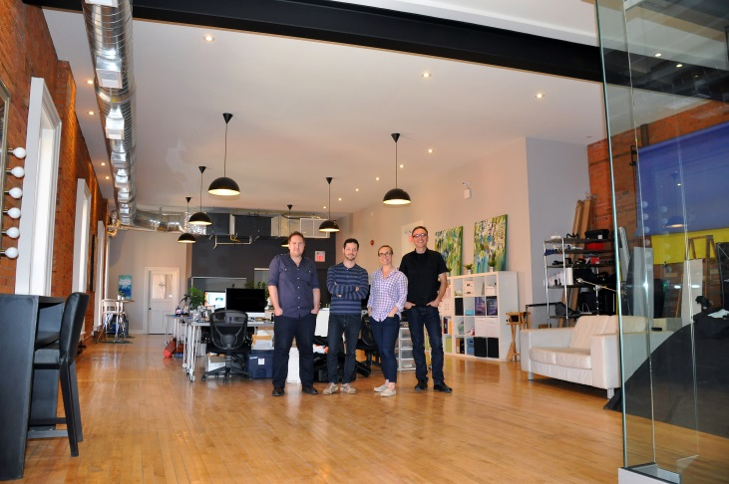
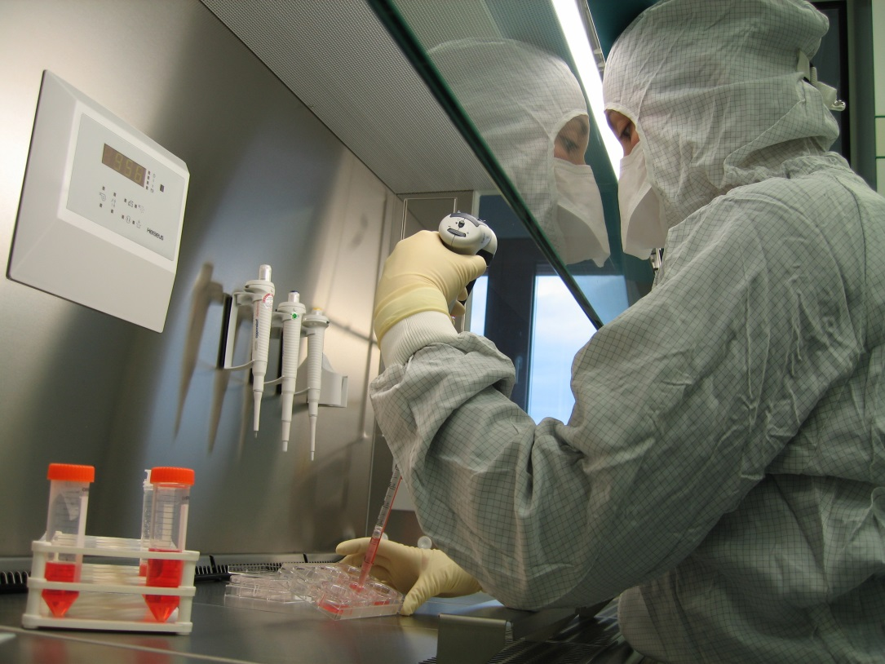
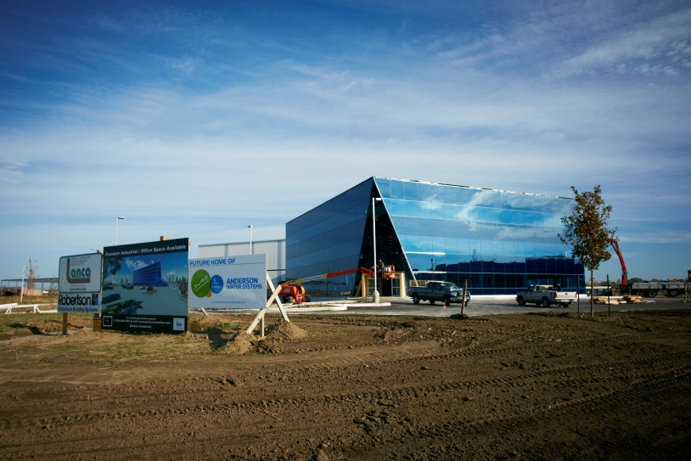
Economic Development Successes
Many great success stories across the City demonstrating Economic Growth
Notes:
Many great success stories across the City demonstrating Economic Growth

Slide 34
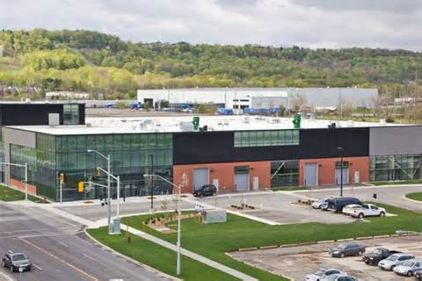
Economic Development Successes
Notes:
Fraunhoffer – City’s investment and support
A partnership between McMaster University and Fraunhofer IZI
One that will pave the way for a unique Biomedical Engineering and Advanced Manufacturing research facility that will make its home at the McMaster Innovation Park.
BEAM, as it’s more commonly referred, will expand the Park’s research capacity, Joining two other internationally recognized research facilities
the McMaster Automotive Research Centre and CANMET the Federal Government’s Metals & Minerals Testing laboratory.
This achievement has been a long time in the making – with several partners working toward the same goal.
This development serves as an excellent example of how various levels of governments can work together with their university partners to capitalize on knowledge-driven economic opportunities.
From the City’s perspective, I’d like to recognize the efforts of:
Neil Everson, Carolyn Reid and Michael Kovacevic of our Economic Development and Legal Services Departments respectively.

Slide 35
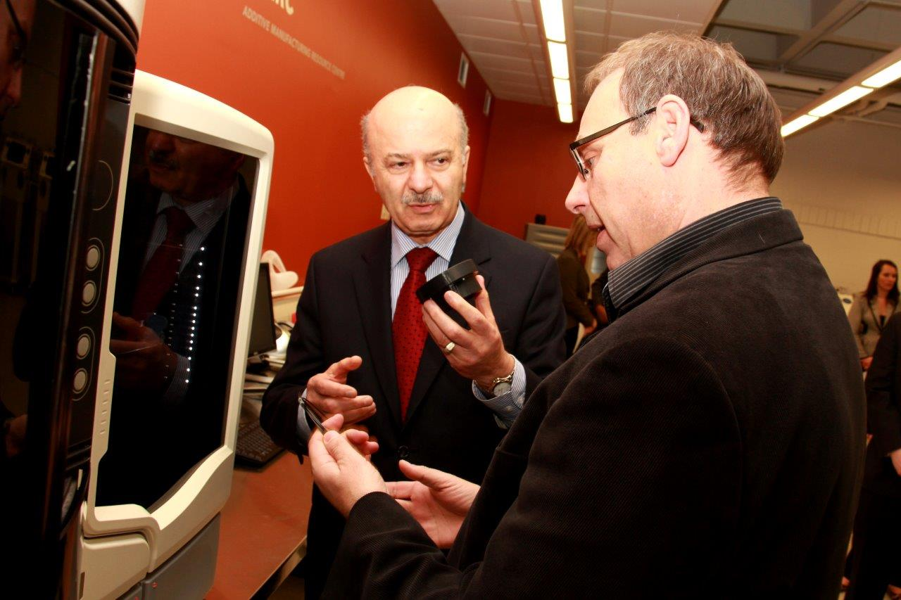
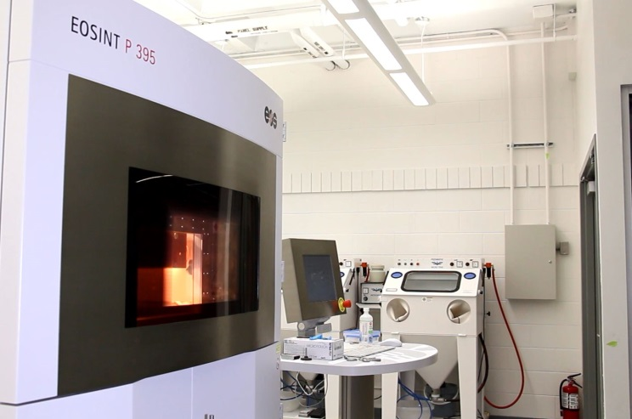
Economic Development Successes
Success Story – Large Academic Institution:
The 3D printing lab at Mohawk College is a major recipient of the latest round of applied research funding.
Notes:
Success Story – Large Academic Institution:
The 3D printing lab at Mohawk College is a major recipient of the latest round of applied research funding.

Slide 36
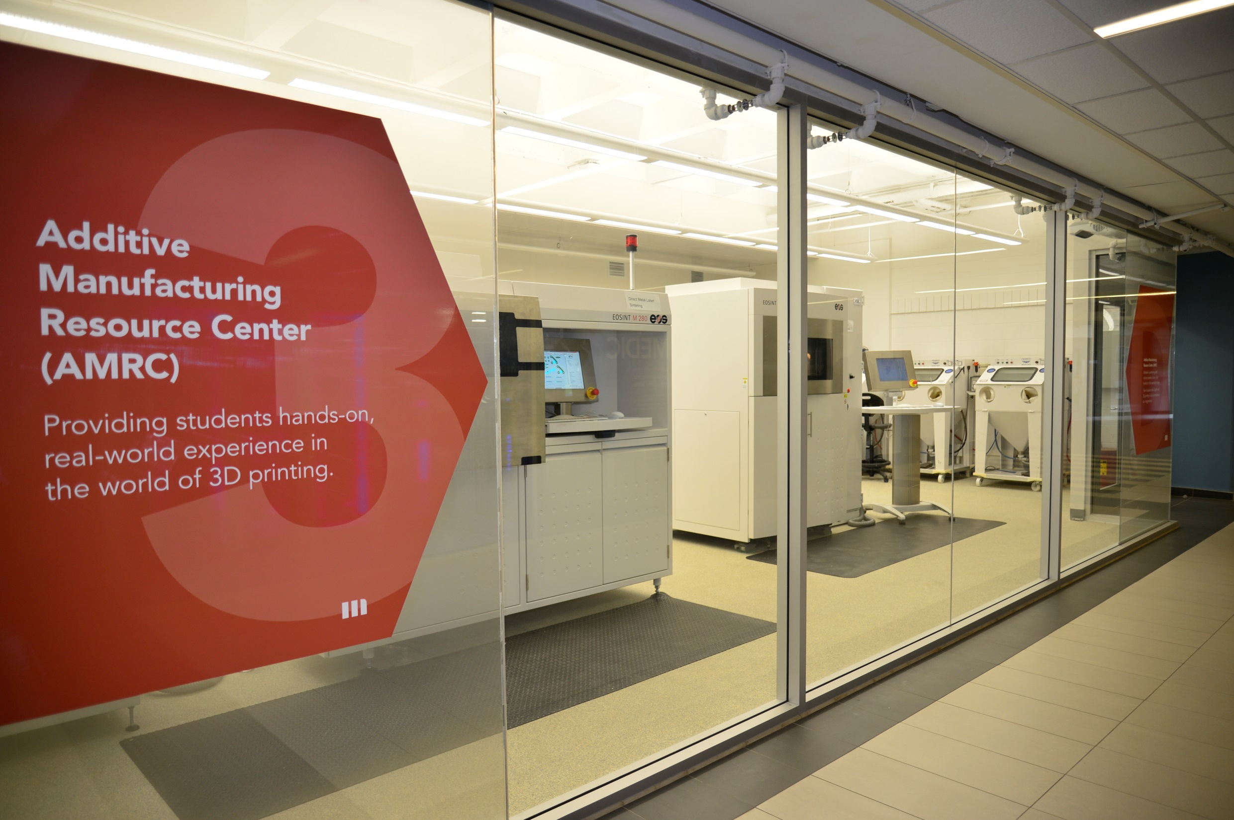
Notes:
The federal government is investing 2.3 million dollars into the college’s Additive Manufacturing Resource Centre
where researchers are working with industry on the development of new products.

Slide 37
Notes:
That includes everything from consumer goods to medical components and satellite components that will go into orbit.

Slide 38
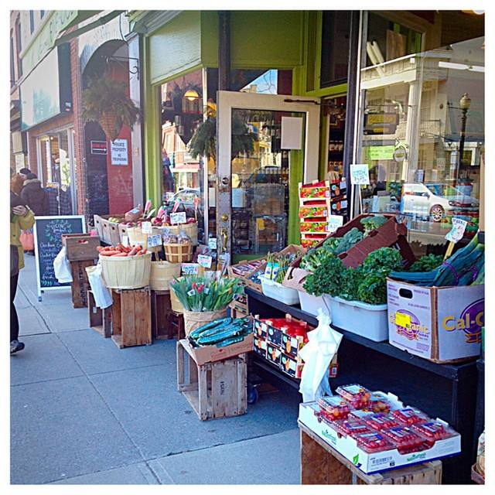
Economic Development Successes
Success Story – Small Family Business:
Nothing speaks to sustainability than being in business for 100 years – Picone Fine Foods, Dundas
Notes:
Nothing speaks to sustainability than being in business for 100 years – Picone Fine Foods, Dundas
Joseph Picone Sr., a newcomer to Canada from Sicily, Italy, sold local produce door to door.
In 1915, he opened Picone’s Food Market and it still operates in the same location today at 34 King Street West in Dundas, Ontario.

Slide 39
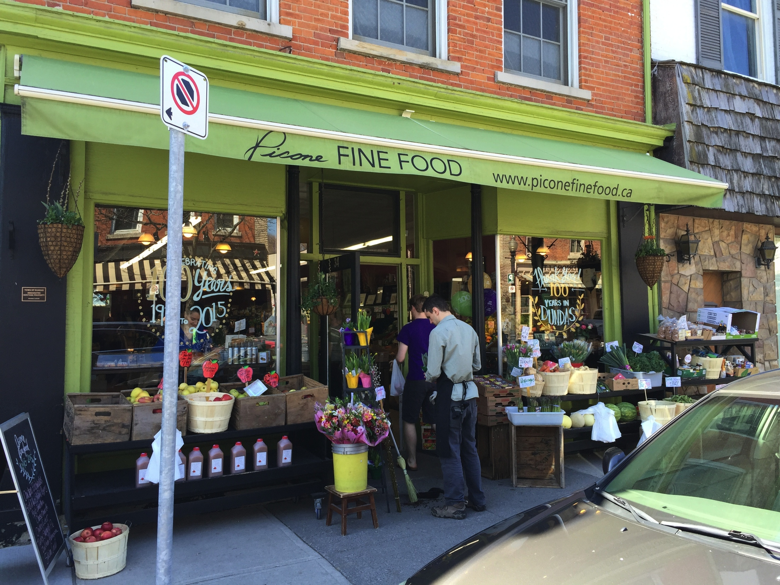
Picone Fine Foods, Dundas
Notes:
community-centered approach to their business is the heartbeat of Dundas
grandfather’s philosophy, 100 years later!
continue to provide fresh, local and organic produce, in-house prepared foods, specialty imported products and promote local culinary artisans

Slide 40
Hamilton: Open for Business
Notes:
Open for Business in Hamilton requires creating faster, smarter and streamlined government-to-business services
Open for Business has three key areas of focus:
Modernizing Municipal Government
Modern Service Delivery
Developing a New Relationship with Business
The aim of Open for Business - to make Hamilton more attractive for new business development, growth, and innovation.

Slide 41
Hamilton: Open for Business
#HAMONT LUNCH
Notes:
We have these numbers and facts to say that Hamilton is Open for Business, but sometimes it’s difficult to show exactly what that means.
I’ll leave you with this: Nothing says we are truly Open For Business like the ‘HamOnt lunch’ – that you can have anywhere in Canada.

Slide 42
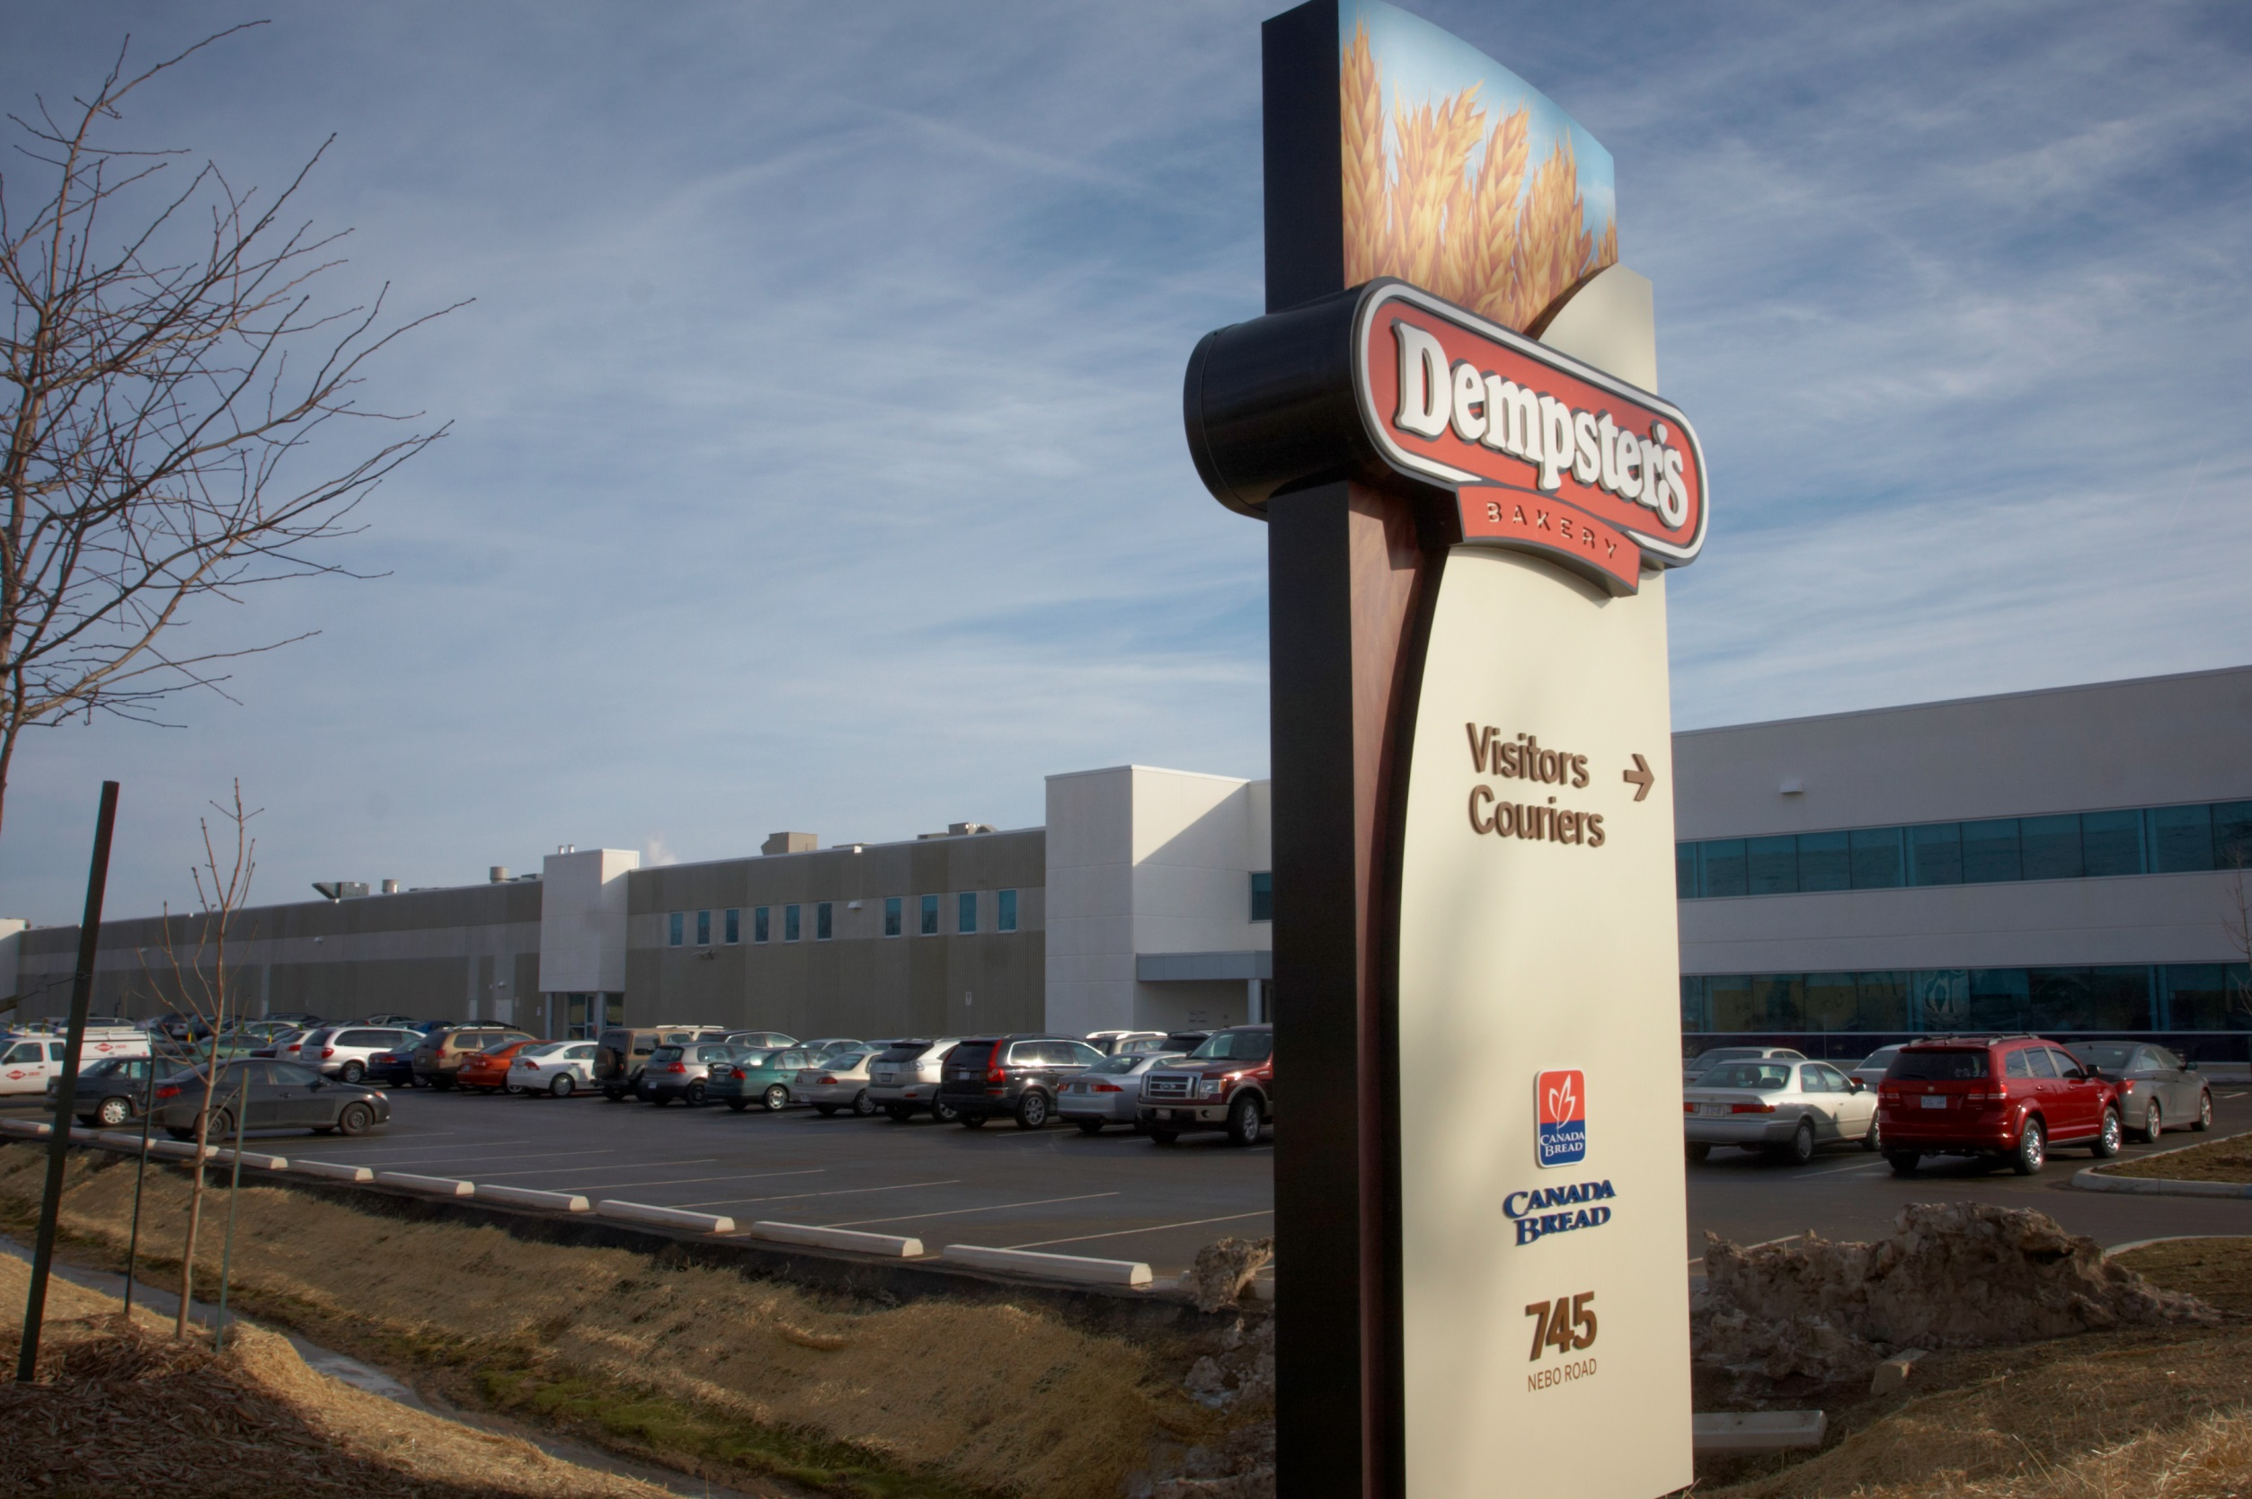
#HAMONT LUNCH
Notes:
2 pieces of Dempsters Bread; made here in Hamilton at Canada Bread

Slide 43
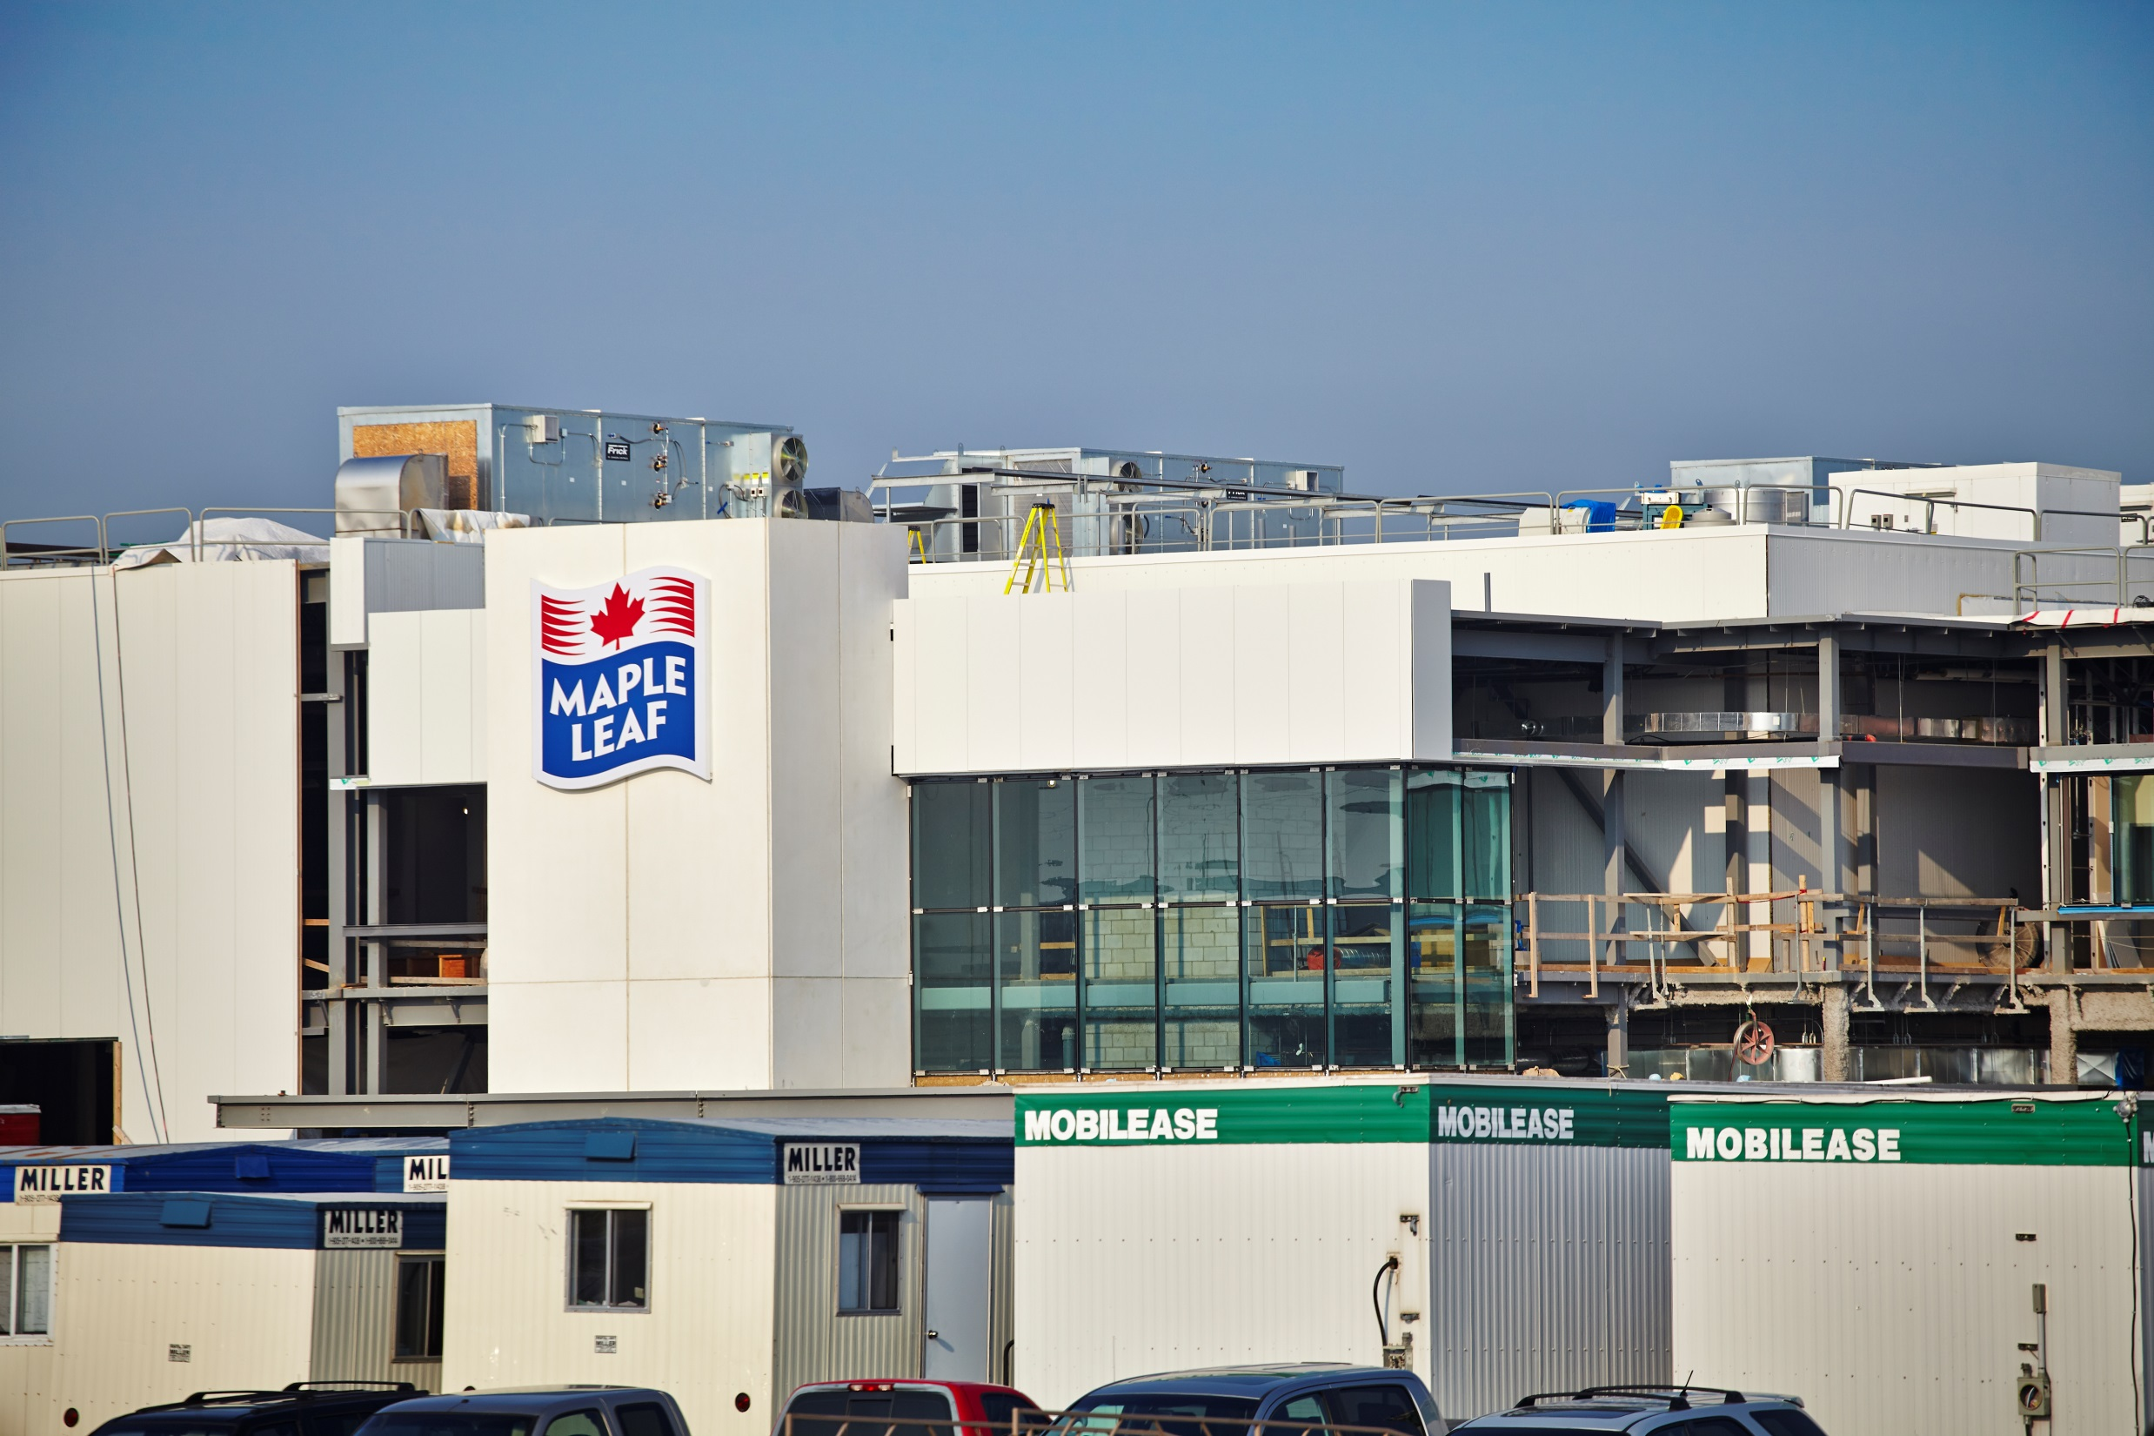
#HAMONT LUNCH
Notes:
a few slices of ham or turkey; from Maple Leaf Foods – here in Hamilton

Slide 44
#HAMONT LUNCH
Notes:
now some mustard; you’re following along right?! – from GS Dunn, here in Hamilton

Slide 45
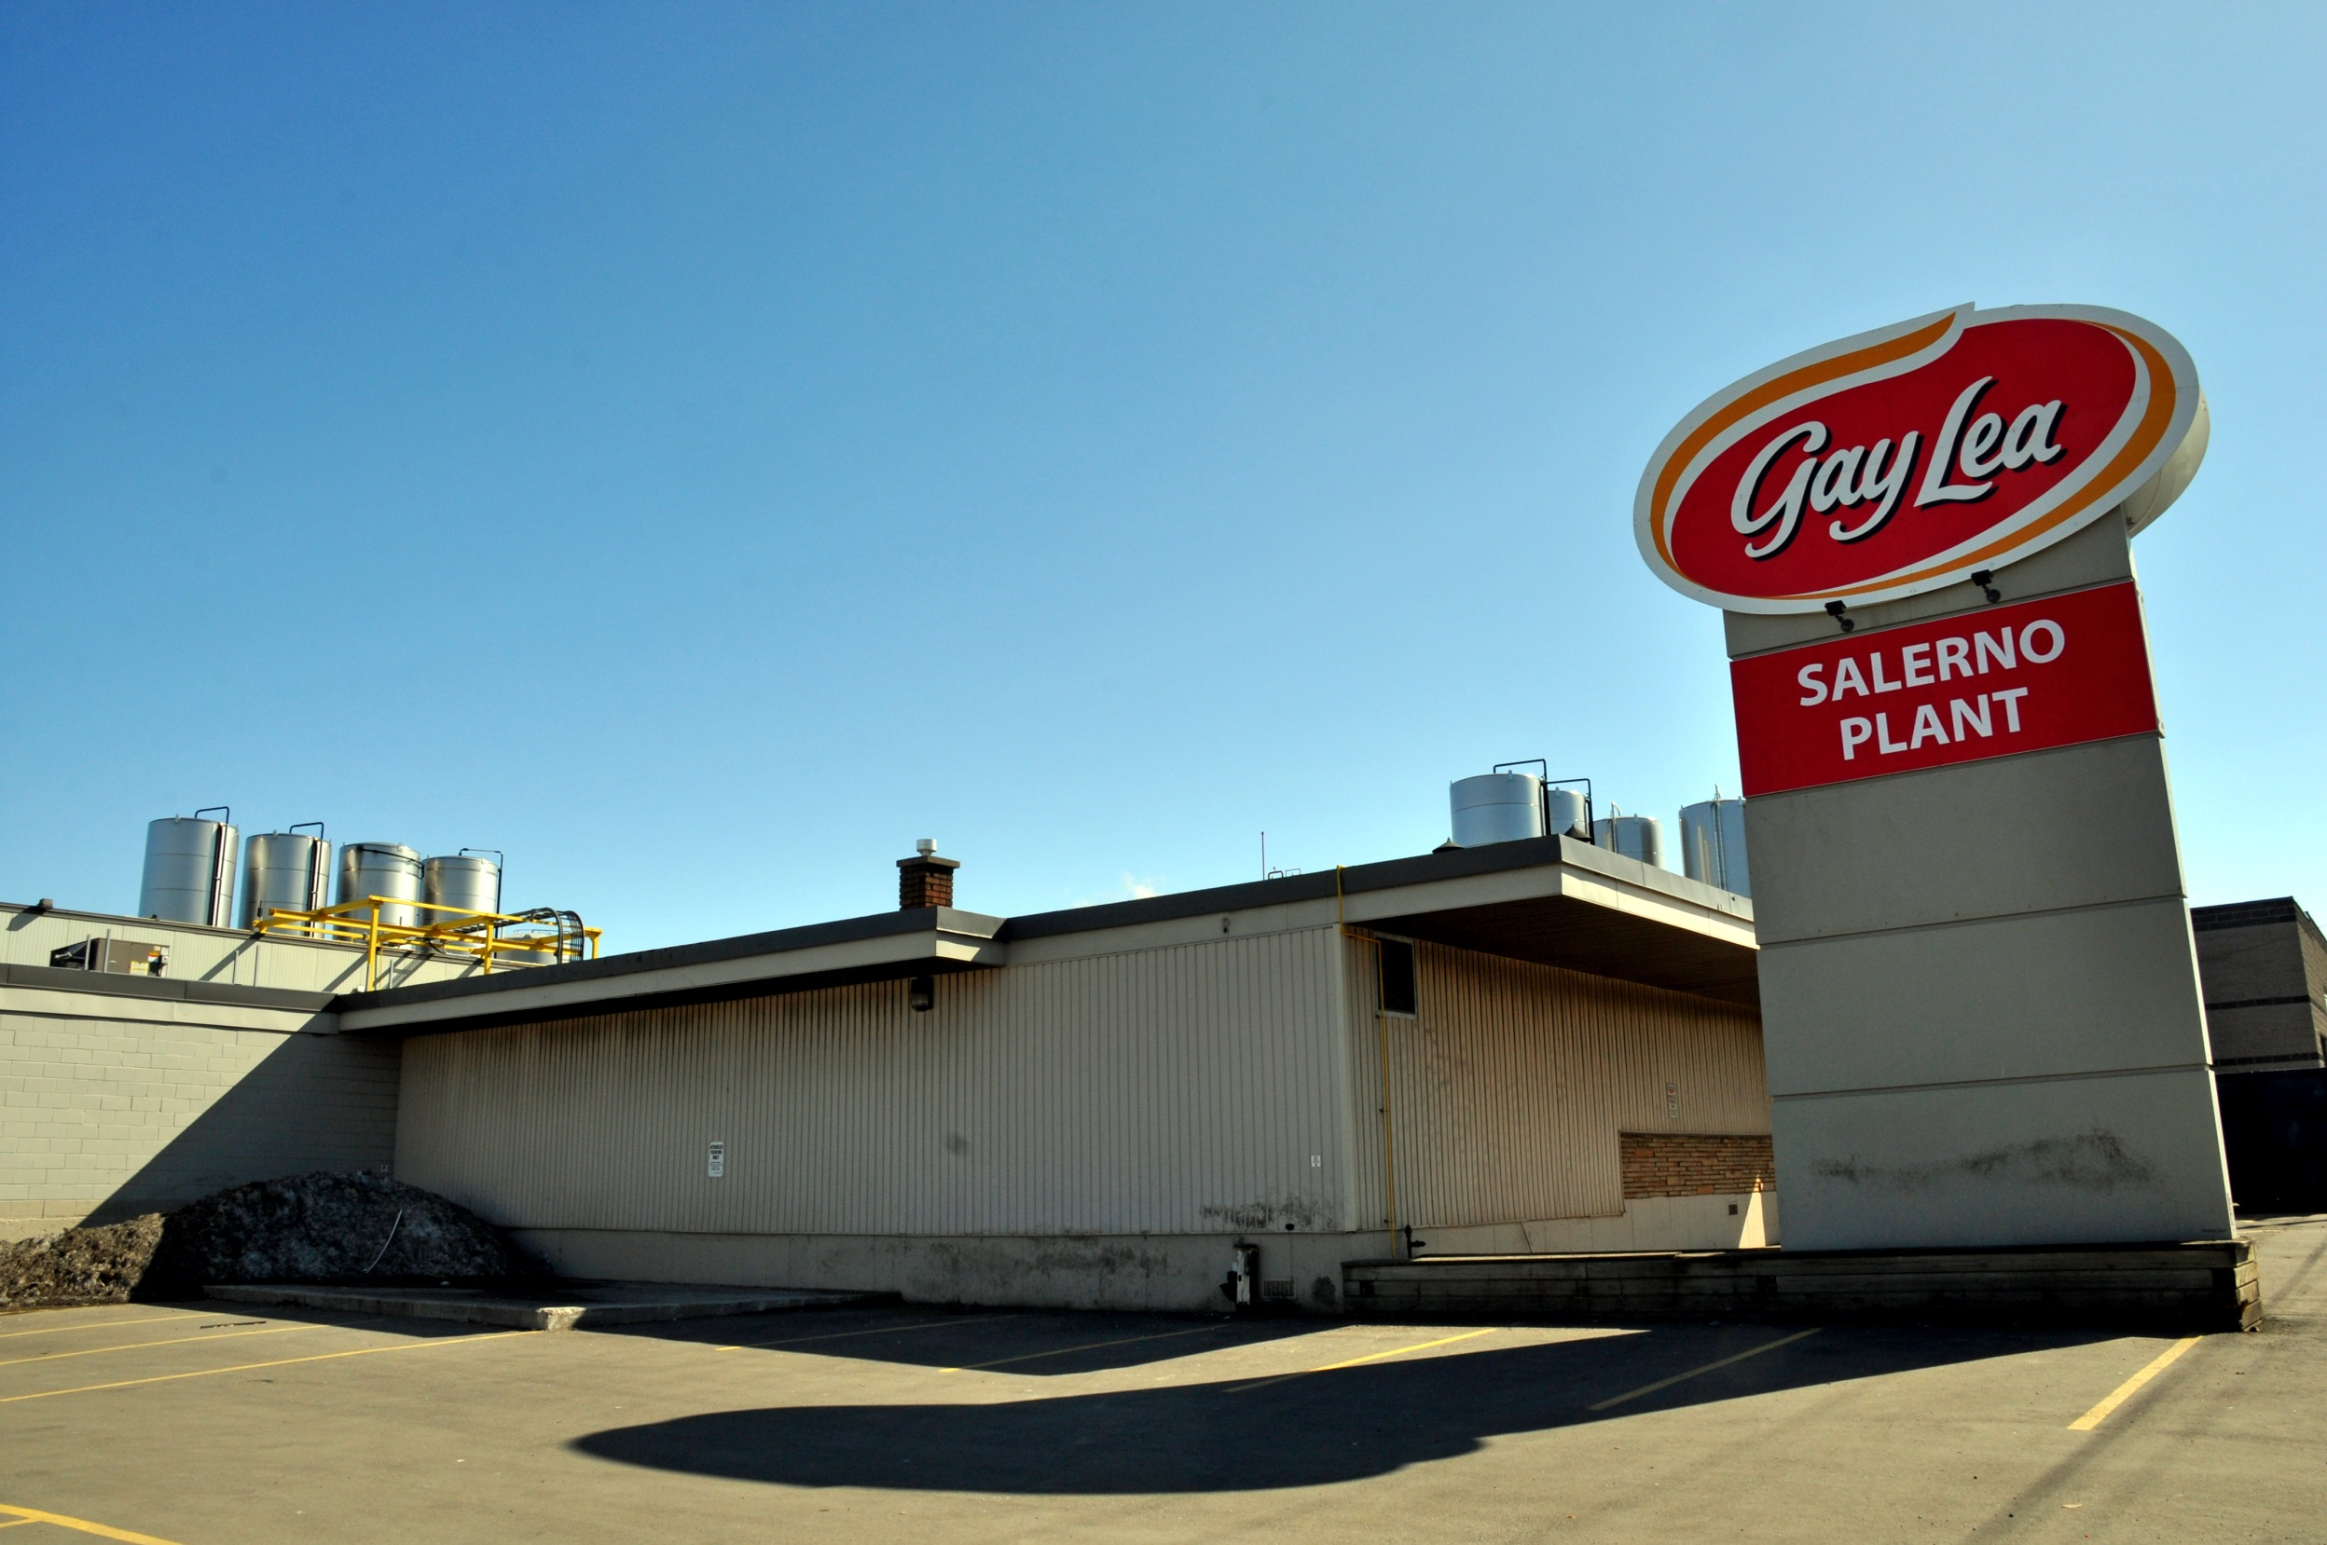
#HAMONT LUNCH
Notes:
Cheese and a Yogurt from Salerno and Gay Lea Foods

Slide 46
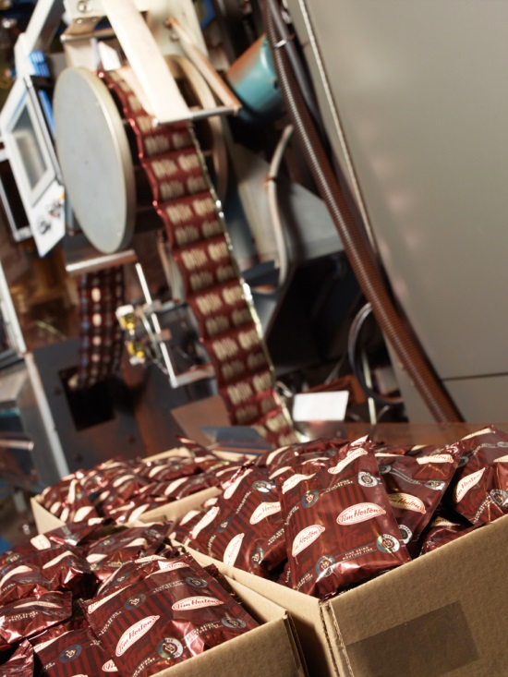
#HAMONT LUNCH
Notes:
And Finally - add a Tim Horton’s coffee – from the roasting facility in Hamilton…
And you have the “HamOnt Lunch” – anywhere in Canada.

Slide 47
We are Open For Business
STRATEGY SIMPLIFIED:
Focus on smart economic growth and jobs and continue to create efficiencies
Invest in our infrastructure in partnership with other levels of government.
Be ready to accept bold and innovate solutions towards building a sustainable, prosperous, vibrant, livable City.
Notes:
We are Open For Business
STRATEGY SIMPLIFIED:
Focus on smart economic growth and jobs and continue to create efficiencies
Invest in our infrastructure in partnership with other levels of government.
Be ready to accept bold and innovate solutions towards building a sustainable, prosperous, vibrant, livable City.

Slide 48
#HAMONT LUNCH
Notes:
Thank you!

